Slide 1

GirlCode 2019
Javascript Workshop 2
Sponsored by Entelect Software
Image credit: Duart Breedt

Slide 2
TOOLS. js

Slide 3

Tools for this workshop
Tooling to make our experience easier
Visual Studio Code A modern Integrated Development Environment (IDE) - Where we’re going to write our code
Web Browser of your choice Chrome, Firefox, Edge, Internet explorer
.HTML and .JS Files You can use .HTML files from an earlier workshop or create some new ones - It’s up to you!
Notes:
Visual Studio Code IDE
Web Browser of choice - Web tools
.HTML and .JS files

Slide 4
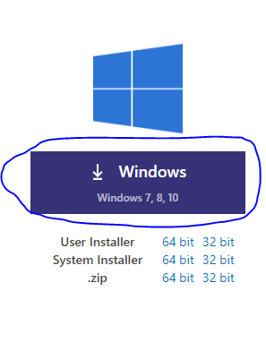

IDE Setup
code.visualstudio.com/download
Open extensions menu
Search for GirlCode
Install the extension
If you don’t have internet access, please let us know!

Slide 5

Slides
http://bit.ly/girlcode-code
http://bit.ly/girlcode-slides (included with code)
If you don’t have internet access, please let us know!

Slide 6
Developer Tools
Simply press F12 on your keyboard and navigate over to your console section.
Please call one of us over if you need help!

Slide 7
.HTML and .js files
Each section has its own exercise files. We will instruct you on when to move to the next exercise

Slide 8
Closures.js

Slide 9
Closures
Important for order of execution Used for explaining what is going on in code
Define scoping Used to tell a story about the problem. That is very specific to the problems domain. Can also be used to document use of functions.
Notes:
Fingers behind the back example
Microscope example

Slide 10
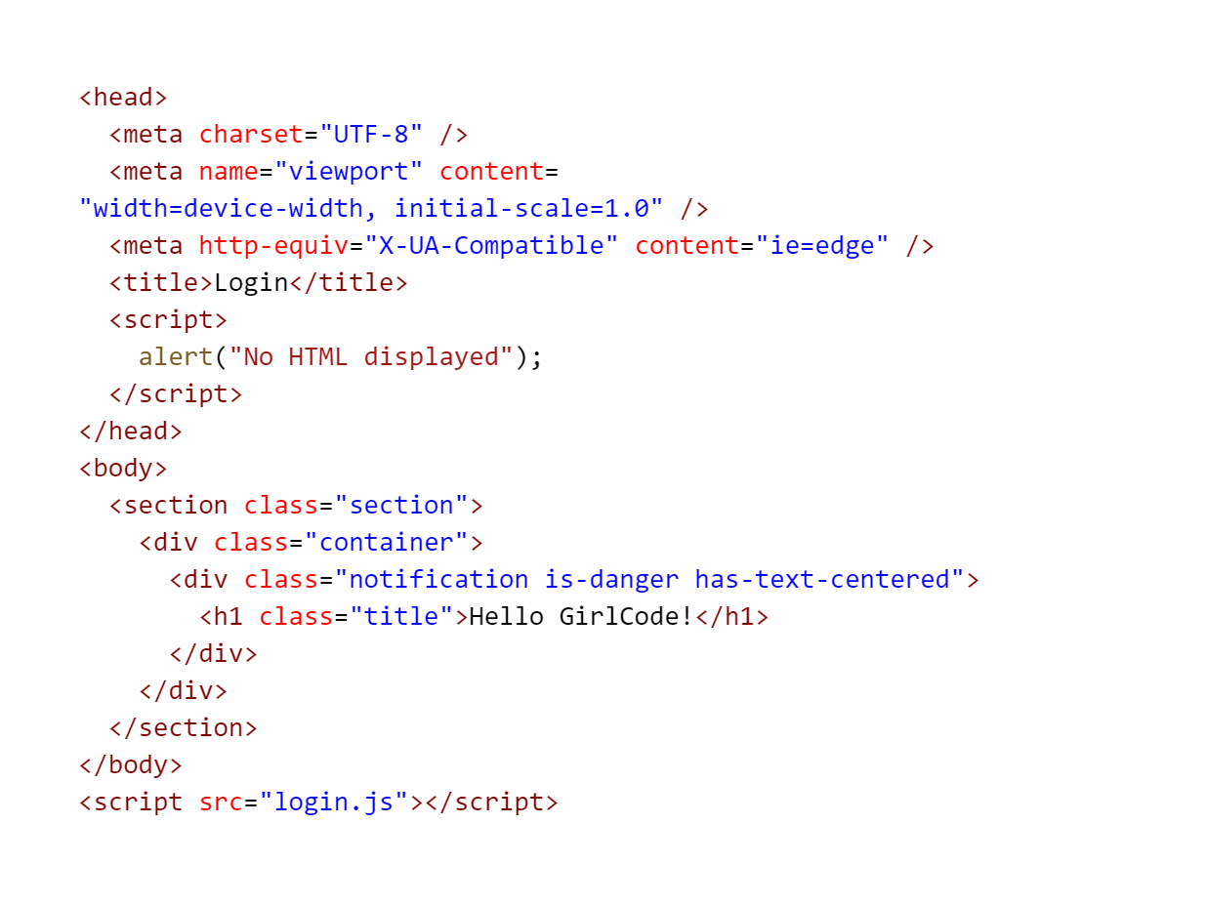
Closures Exercise
Closures are important for order of execution
Head always happens first
Body happens next
This call will happen after the body

Slide 11
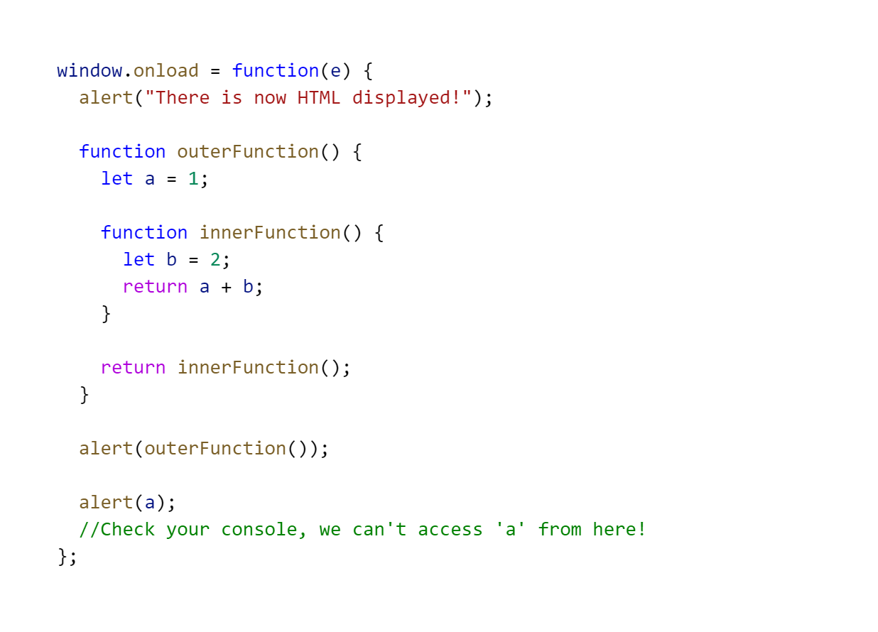
Closures Exercise 2
Closures are important for order of execution

Slide 12
Selectors. js

Slide 13
Selectors
Used to Select items on the HTML Page Labels, Text, images and more
Uses attributes to select items Get By ID, Class, or others
Allows us to get values from and put values back into the page This is the start of how we use JS to cause changes to our websites (Dynamic web pages)

Slide 14
Selectors
document This variable is given to us by the browser, and allows us to access the page
document.getElementByID(“subtitle”)
Provides us access to an HTML element using the “id” tag on that element
document.getElementsByClassName(“card-title”)
Gives us an Array of HTML elements which have the same “class” tag
Notes:
document.getelementbytagname

Slide 15
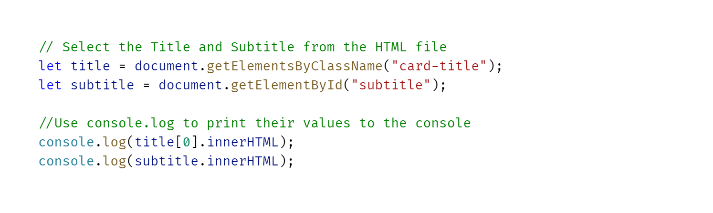
Selectors Exercise
Using Selectors to get data

Slide 16
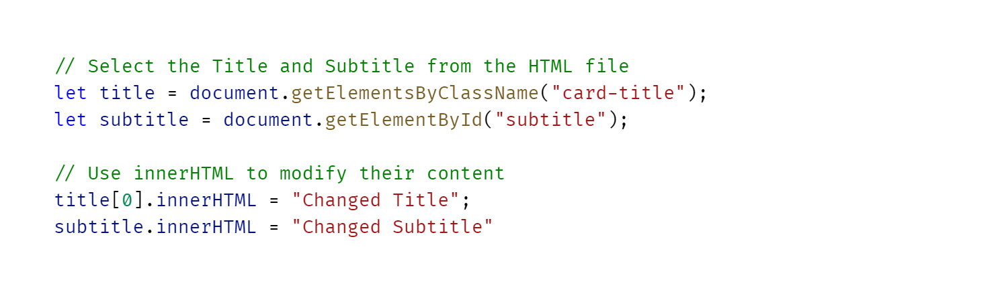
Selectors Exercise
Using Selectors to change data
Notes:
Explain innerHTML as a variable that contains the inner value of an HTML tag

Slide 17
Input Handling.js

Slide 18
Input Handling
We need to be able to get a user’s input! We can combine selectors with html <input> tags to do this
Validations We can also use Javascript to validate a user’s input, such as a long enough password, and more We’re going to see these in action later!

Slide 19
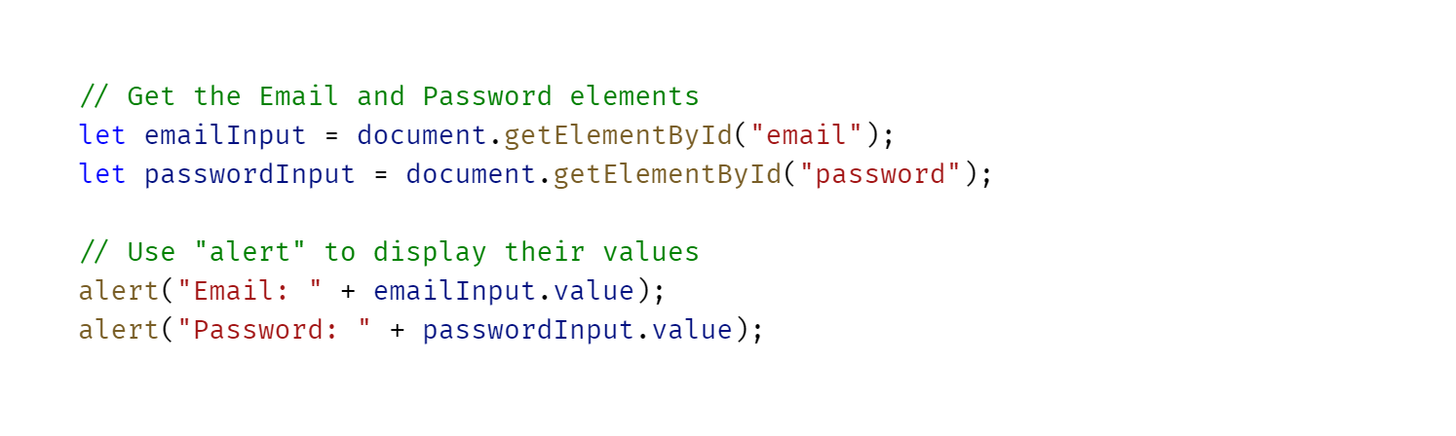
Getting an Input’s value
Notes:
How you comment single lines

Slide 20
Events.js

Slide 21
Events
We need to handle actions from users We do this with events.
How are events added We use the on selector on html elements or the event listners

Slide 22
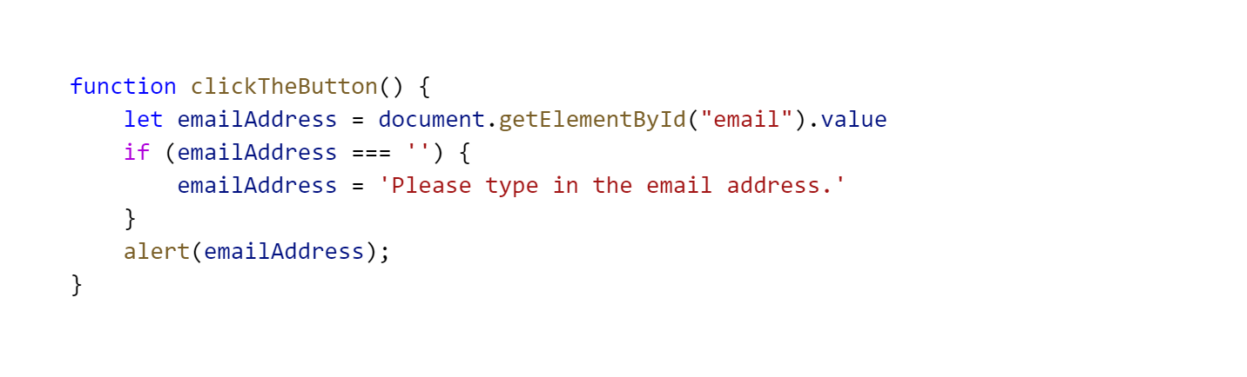
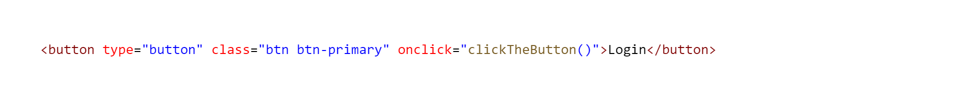
Click Event

Slide 23
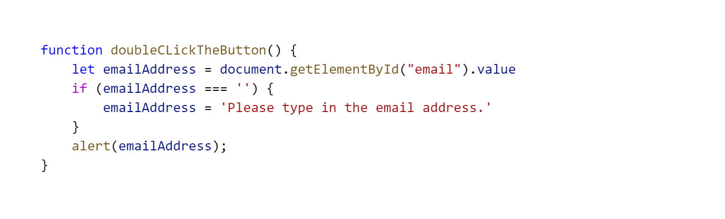
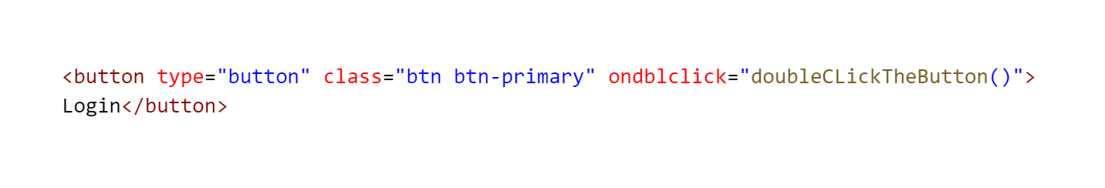
Double Click Event

Slide 24
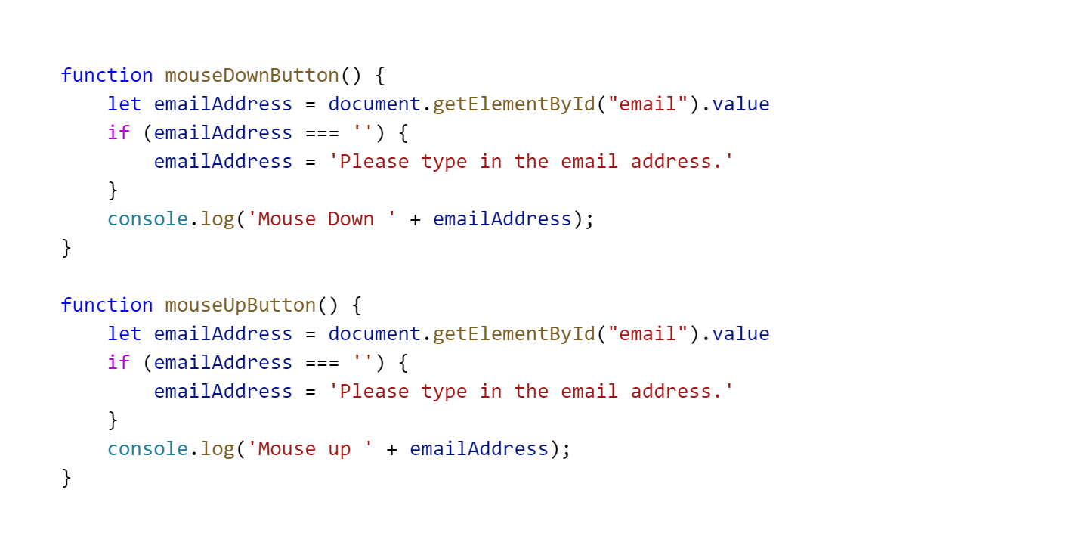
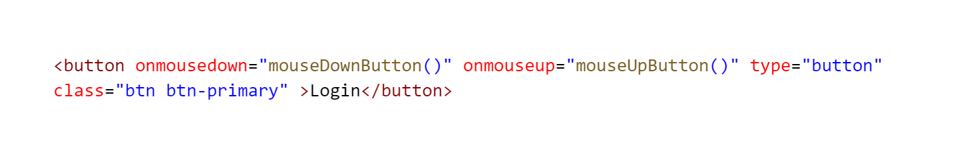
Mouse Up and Mouse Down Event

Slide 25
Changing the DOM.js

Slide 26
Changing the dom
What is the dom The dom is short for Document Object Model
Why do we need to change the dom This is how javascript adds to a web page.
How do we add to the There are multiple pure javascript functions that can be used

Slide 27
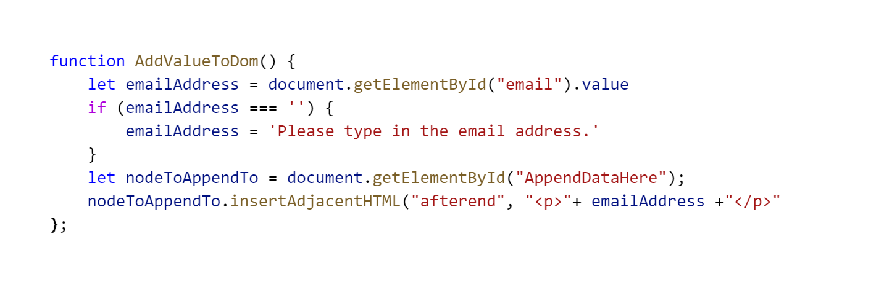
Add a single value to the dom

Slide 28
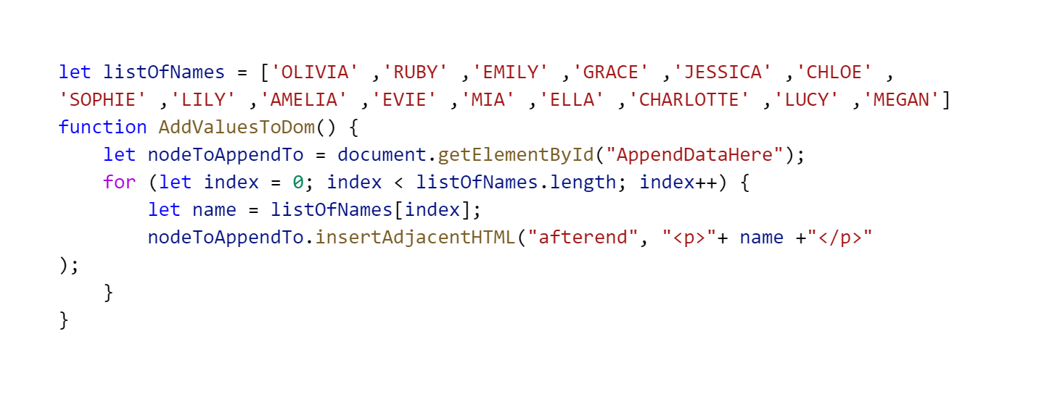
Add a multiple values to the dom

Slide 29
Forms.js

Slide 30
Forms
What are forms used for Allows a user to post data to a server
Validation is used to check the form before submission All0ws client side validation

Slide 31
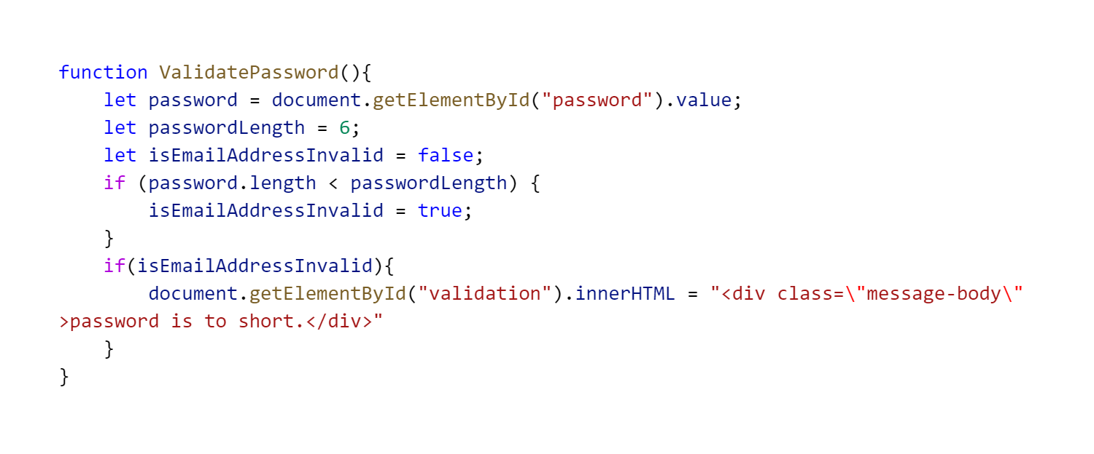
Form Validation

Slide 32
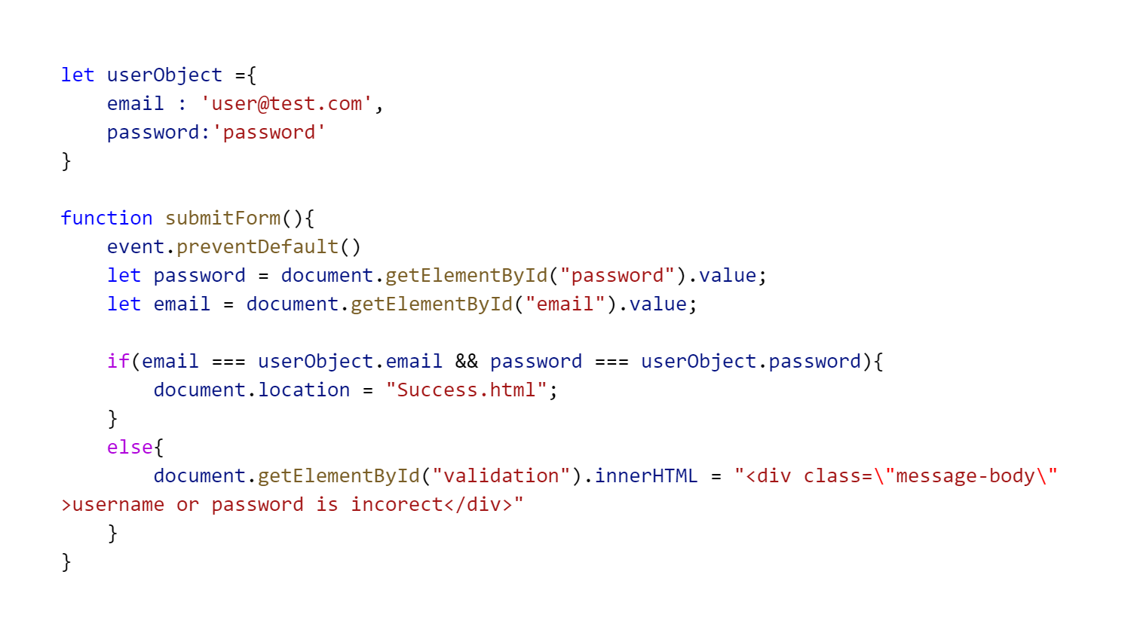
Submit a form

Slide 33
Prompt_Confirm.js

Slide 34
Prompt and Confirm
Prompt Good for prompting users to input something small
Confirm Good for getting confirmation from users
Notes:
Fingers behind the back example
Microscope example

Slide 35
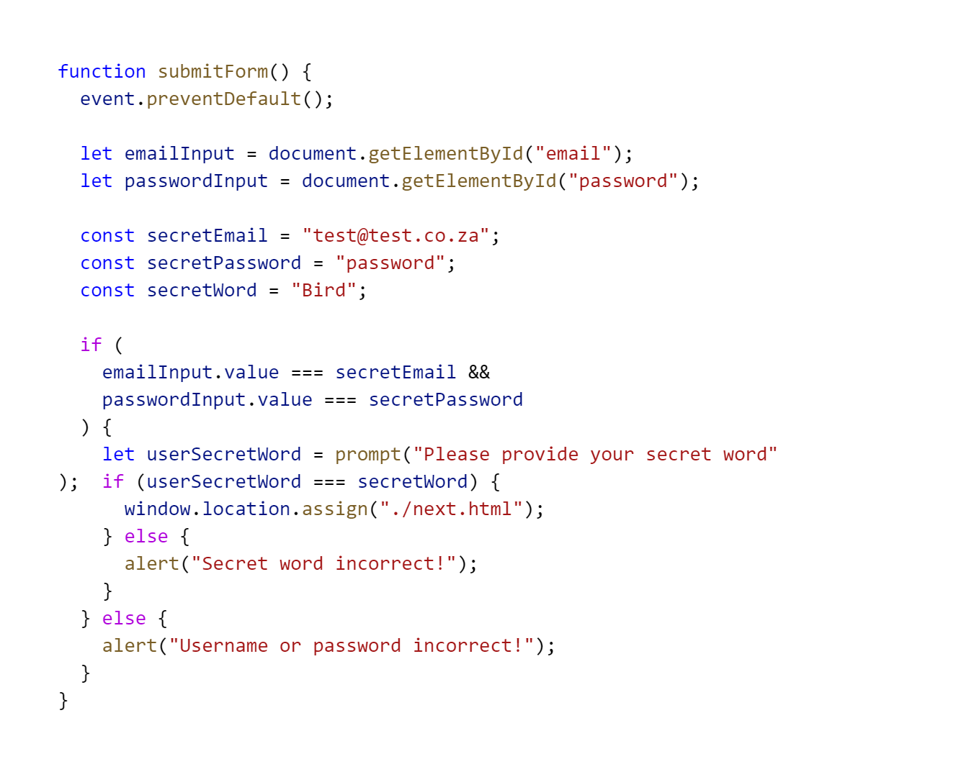
Prompt Exercise
Prompt helps your users

Slide 36
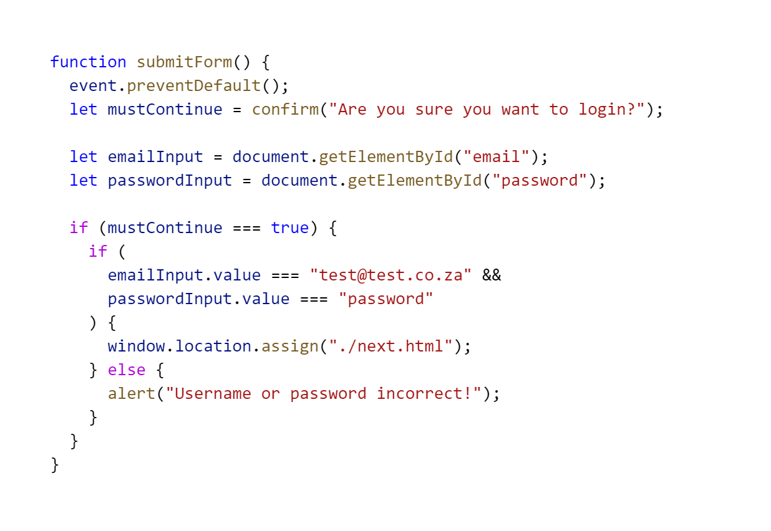
Confirm Exercise
Confirmation can be very useful

Slide 37
Let’s CODE
Something

Slide 38
Real World API Call
API Application Programming Interface - our application is going to be programmed to interface with theirs, this will require us to ask their application for some information
Fetch We FETCH the information from their API. It’s a special way of asking. Because we’re working with something that won’t be instant, we’re going to have to wait for a bit.
Synchronous vs Asynchronous Code that we’ve written so far is Synchronous, it’s nearly instant. Things that we have to wait for are called Asynchronous.
Promises In Asynchronous code, we get the data source to promise to return us some information later, and catch what happens if the promise doesn’t work out.
Notes:
Fingers behind the back example
Microscope example

Slide 39
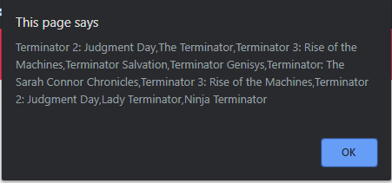
API Call
Let’s get some data from somewhere online!
Let’s remix it to get another movie franchise!

Slide 40
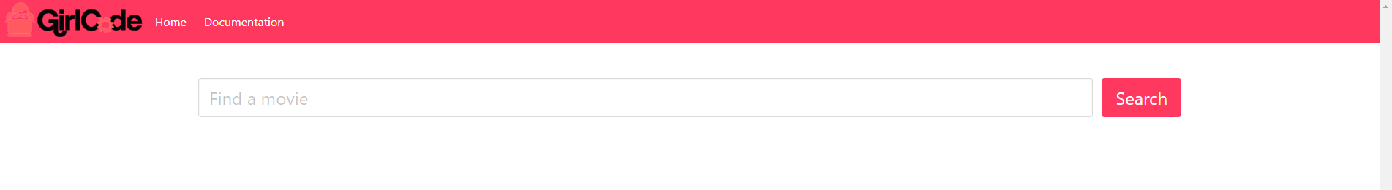
API Call
We can do better!

Slide 41
Rules For Remixing
Share Your Passion
It’s OKAY to make misterks mistakes
Enjoy Yourself

Slide 42
References
https://javascript.info/function-basics
https://javascript.info/array
https://quizlet.com/236992008/mjs-array-methods-flash-cards/
https://www.i-programmer.info/babbages-bag/263-stacks.html
https://javascript.info/while-for#tasks

Slide 43
Test
http://bit.ly/girlcode-test
If you don’t have internet access, please let us know!

Slide 44
RESOURCE SLIDES AFTER THIS POINT

Slide 45
Links
Comparison Operators
https://apprize.info/javascript/20lessons/4.html
https://www.w3schools.com/js/js_comparisons.asp

